Slide 1
Communication Skills
4

Slide 2
Learning Objectives
L
1
Explained the importance of collaborative, two-way communication in personal selling.
Explain the primary types of questions and how they are applied in selling.
Illustrate the diverse roles and uses of strategic questioning in personal selling.
Identify and describe the five steps of the ADAPT questioning sequence for effective fact-finding and needs discovery
L
2
L
3
L
4

Slide 3
Learning Objectives
L
5
Discuss the four sequential steps for effective active listening.
Discuss the superiority of pictures over words for explaining concepts and enhancing comprehension.
Described and interpret the different forms of nonverbal communication.
L
6
L
7

Slide 4

Sales Communication as a Collaborative Process
Trust-based sales communication: A ___________ and two-way form of communication that allows buyers and sellers to develop a better understanding of the need situation and work _________________ the best response for resolving the customer’s needs.

Slide 5


Strategic Questioning
Control the flow & direction of the conversation
__________ the customer’s understanding
Demonstrate ________ & understanding
Uncover important information

Slide 6
Controlling Amount and Specificity of Information
Open-end Questions
Closed-end Questions
Dichotomous/Multiple-Choice Questions
___________________________
___________________________
___________________________
Purposeful, carefully _________ questions can encourage thoughtful responses from the buyer.

Slide 7
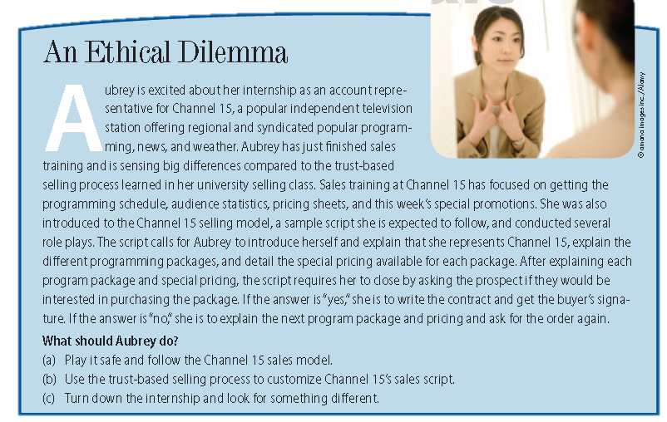
Ethical Dilemma

Slide 8
Types of Questions: Strategic Purpose
Probing Questions – designed to ________________ ____________________________________
1. Requesting Clarification
“Can you share an example of that with me?”
2. Encouraging Elaboration
“How are you dealing with that situation now?”
3. Verifying Information and Responses
“So, if I understand you correctly . . . . . . is that right?”

Slide 9
Types of Questions: Strategic Purpose
Evaluative Questions – use open- and closed-end question formats ________________ and to uncover attitudes, opinions, and preferences of customer.
“How do you feel about…?”
“Do you se the merits of…?”
“What do you think…?”

Slide 10
Types of Questions: Strategic Purpose
Reactive Questions – refer to or directly result from information previously provided by the other party.
“You mentioned that …Can you give me an example of what you mean?”
“That is interesting. Can you tell me how it happened?”
Tactical Questions – used to _____ or ________ the topic of discussion
“Earlier you mentioned that…”
“Could you tell me more about how that might affect…”

Slide 11
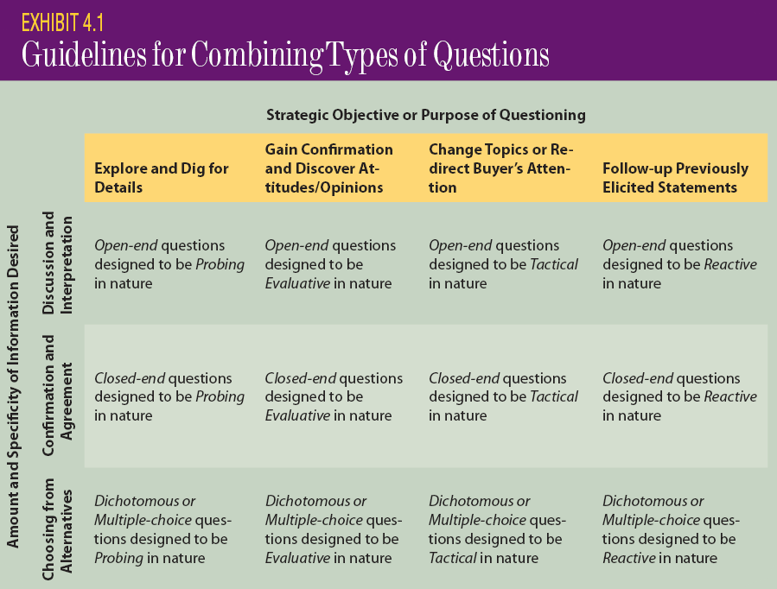
Guidelines for Combining Types of Questions for Maximal Effectiveness

Slide 12
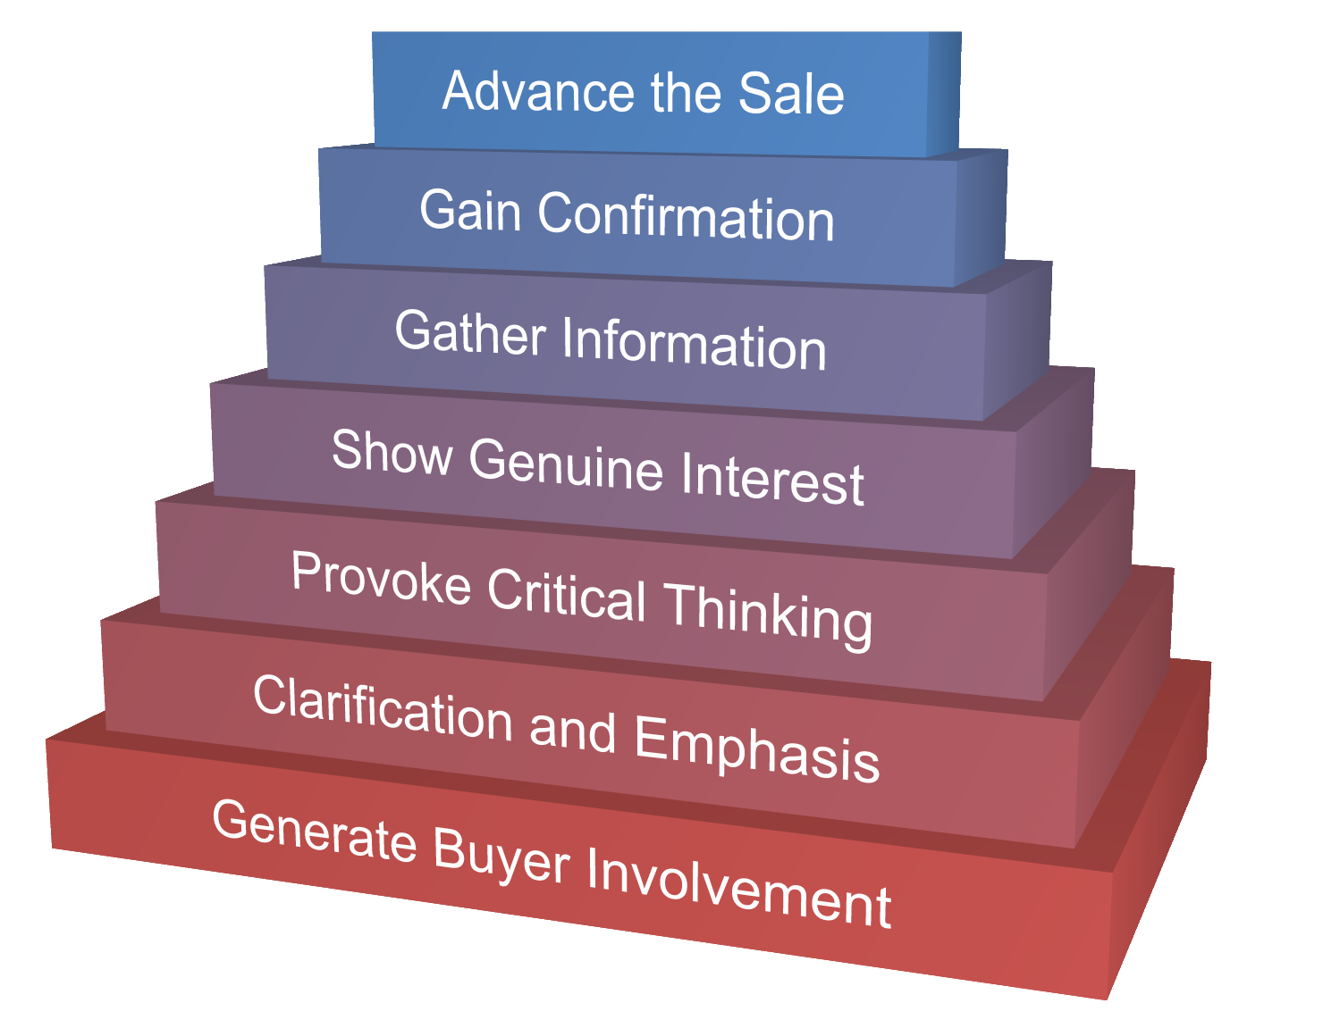
Strategic Application of Questioning In Trust-Based Selling

Slide 13
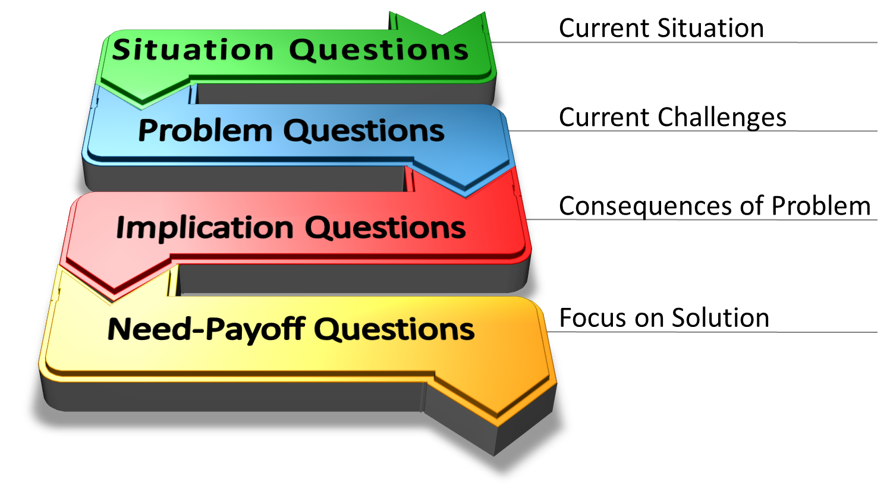
SPIN

Slide 14
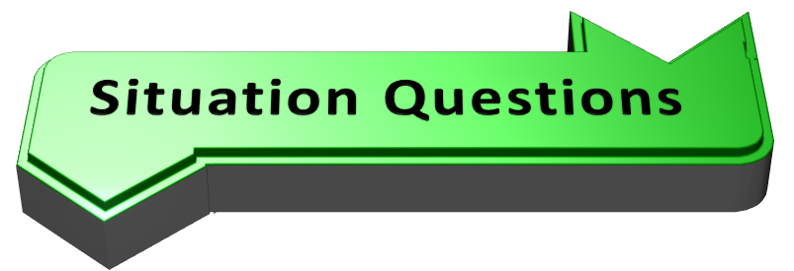
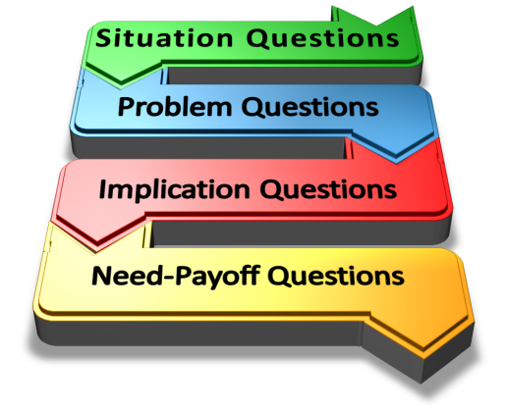
Definition:
Finding out facts about the buyer’s existing situation.
Examples:
How many people do you employ at this location? Can you please describe your payroll process?
Impact:
Least powerful of the SPIN questions. Negative relationship to success. Most people ask too many.
Advice:
Eliminate unnecessary Situation Questions by doing your homework in advance.

Slide 15
Problem Questions
Definition:
Asking about problems, difficulties or dissatisfactions that the buyer is experiencing with the existing situation.
Examples:
What sorts of challenges do you face with your payroll process? Have ever had trouble getting the payroll processed on-time?
Impact:
More powerful than Situation Questions. People ask more Problem Questions as they become more experienced at selling.
Think of your products or services in terms of the _________________________—not in terms of the details or characteristics that your products possess.
Advice:

Slide 16
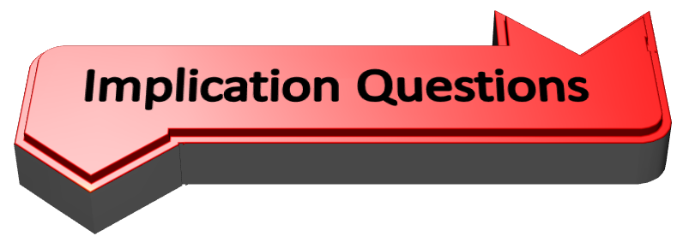
Definition:
Asking about the consequences or effects of a buyer’s problems, difficulties, or dissatisfactions.
How do your employees feel when the payroll process is delayed? Do you have additional expenses as a result of having trouble with the payroll process? How much?
Examples:
Impact:
The most powerful of all SPIN questions. Top salespeople ask lots of Implication Questions.
Prepare for these questions by __________ and ______________ the implications of various suspected needs prior to the sales call.
Advice:

Slide 17
Need-Payoff Questions
Definition:
Asking about the value or usefulness of a proposed solution.
How would your employees respond if you could assure them they will always receive their paychecks on time? Would you like to learn more about how we can help you accomplish this?
Examples:
Impact:
These questions help the buyer to understand the benefits of solving the problem.
Advice:
Use these questions to get buyers to _______ the _______ that your solution can offer.

Slide 18
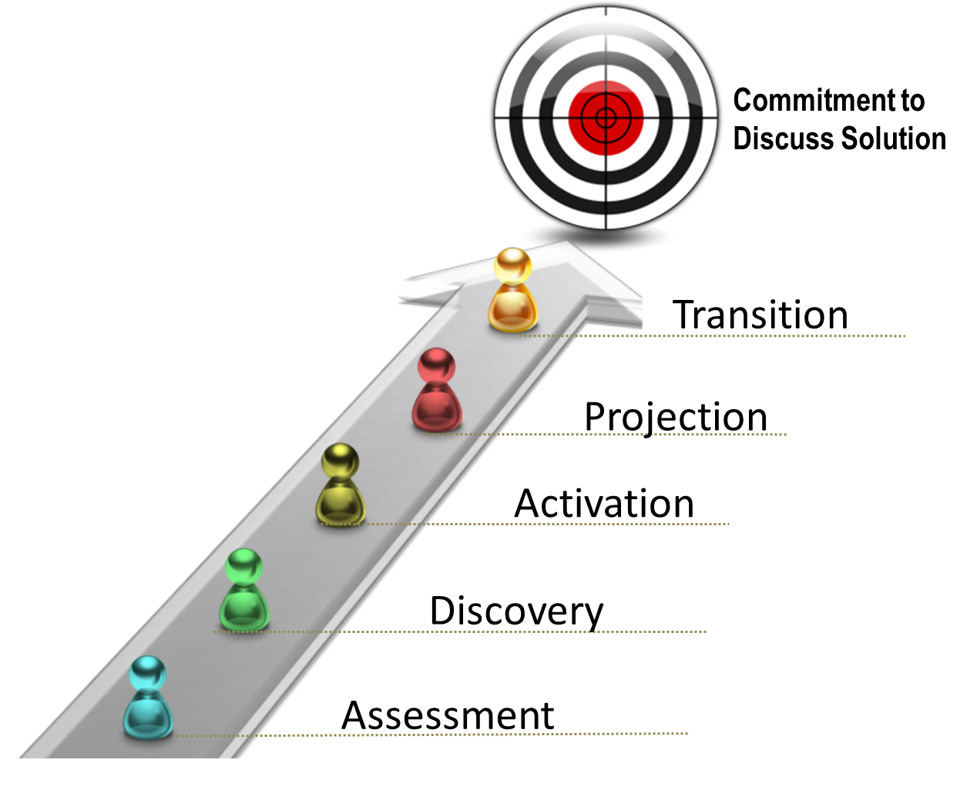
ADAPT Questioning Sequence

Slide 19


Assessment Questions
Broad bases and general facts describing situation
Non-threatening as no interpretation is requested
Open-end questions for maximum information
Examples:
What types of operating arrangements do you have with your suppliers?
Who is involved in the purchase decision-making process?

Slide 20

Discovery Questions
Questions ________________ gained in assessment
Seeking to _______________ or dissatisfactions that could lead to suggested buyer needs
Open-end questions for maximum information
Examples:
I understand you prefer a JIT relationship with your suppliers – how have they been performing? How do you feel about your current suppliers occasionally being late with deliveries?

Slide 21

Activation Questions
Show the _____________ of a problem discovered in the discovery sequence
Designed to ___________________ in and desire to solve the problem.
Examples:
What effect does your supplier’s late delivery have on your operation? If production drops off, how are your operating costs affected, and how does that affect your customers?

Slide 22

Projection Questions
Projects what life would be like without the problems
_______________________ of finding and implementing a solution
Examples:
If a supplier was never late with a delivery, what effects would that have on your JIT operating structure? If a supplier helped you meet the expectations of your customers, what impact would that have on your business?

Slide 23

Transition Questions
Confirms interest in solving the problem
Transitions to presentation of solution
Examples:
So having a supplier who is never late with deliveries is important to you? If I can show you how our company ensures on-time delivery, would you be interested in exploring how it could work for your organization?

Slide 24

Verbal Communication: Listening
Pay
Attention
Make No
Assumptions
Monitor
Non-Verbal
Effective Active Listening
Encourage
Buyer to Talk
Paraphrase
& Repeat
Visualize

Slide 25
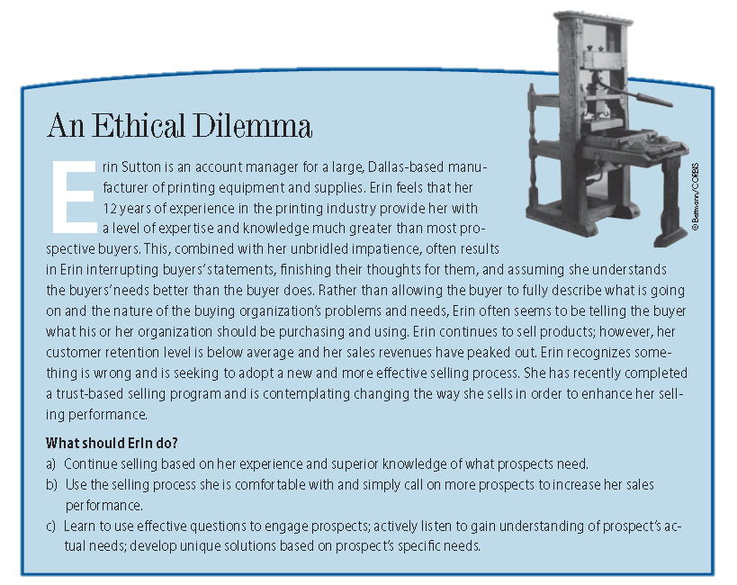
Ethical Dilemma

Slide 26


Types of Listening
Little ____________ or Cognition
Social Listening
Requires ____________ and Cognition
Serious Listening

Slide 27
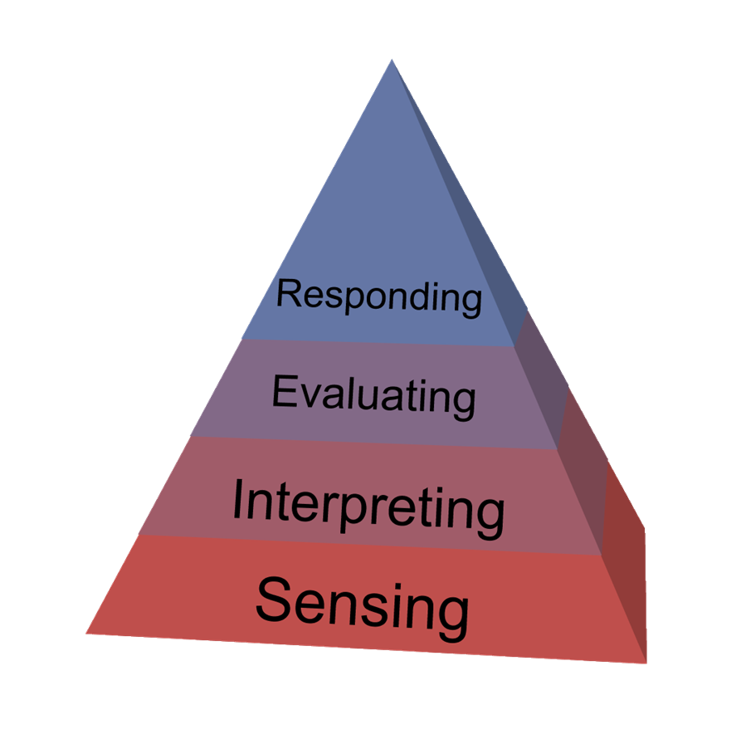
SIER Hierarchy of Active Listening
Active Listening: The _____________ of actively sensing, interpreting, evaluating, and responding to the verbal and nonverbal messages.

Slide 28
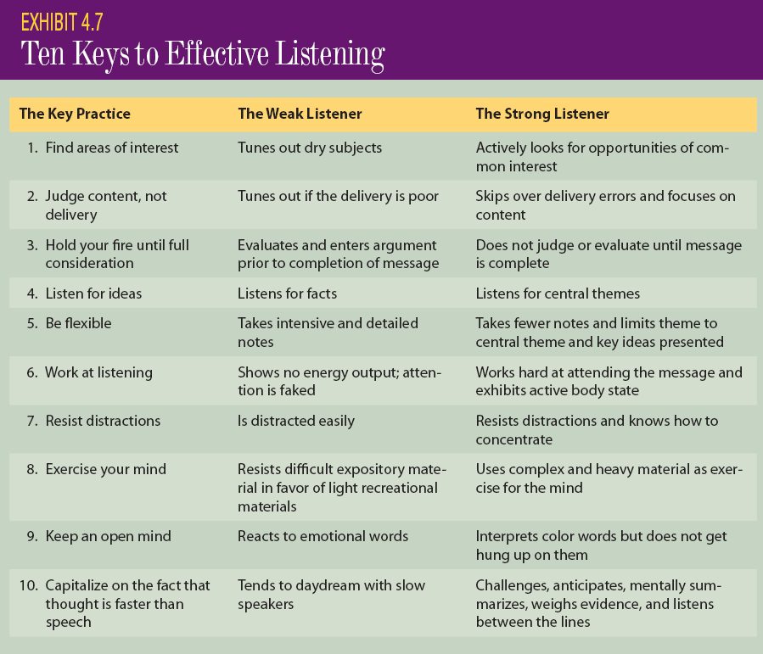
Effective Listening

Slide 29

Understanding the Superiority of Word Pictures
Generate a ____________ in the receiver’s mind.
Use words and phrases that convey concrete and detailed meaning.
__________ relevant visual aids into verbal communication.
“Tropicana juices are bursting with flavor.”
“This new system will increase weekly production by 2,100 units.”
“As you can see by this chart . . . .”

Slide 30

Impact of Poor Grammar
Meaning and credibility of the message are _____________________.
Receiver begins to focus on the sender rather than the message.
Receiver dismisses the sender and the sender’s organization as being ___________ to perform the role of an effective supplier and partner.

Slide 31
Impact of Poor Logical Sequencing
Presentation will be ______________________.
Receiver will have to ask many questions to gain clarity.
Receiver may _________________ as incompetent.

Slide 32




Nonverbal Communication
Facial Expressions
Eye Movements
Placement and Movements of Hands, Arms, Head, and Legs
Body Posture and Orientation
Proxemics
Variation in Voice Characteristics
Speaking Rate and Pause Duration
Pitch or Frequency
Intensity and Loudness
50% or more of the meaning conveyed in interpersonal communication comes through nonverbal behaviors.

Slide 33
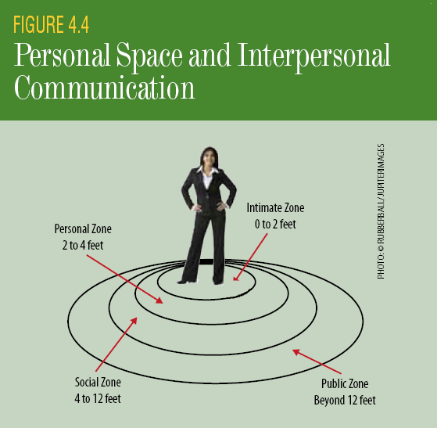
Proximics

Slide 34
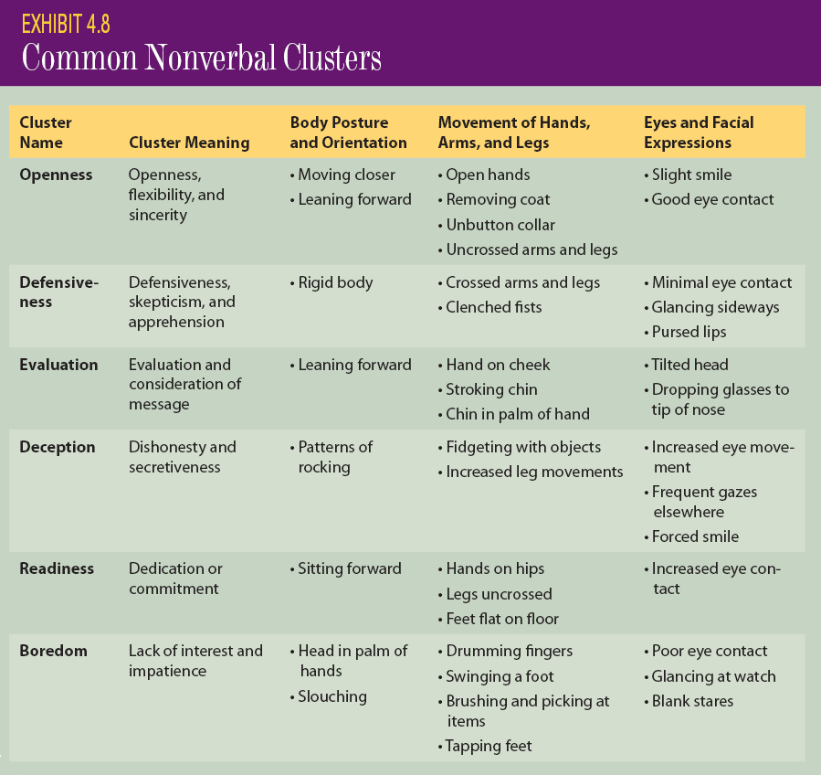
Common Nonverbal Clusters

